Slide 1

CTE New Member Self-INTRODUCTION
Mxa DS Team
Data Science Engineer
Haoming Xu

Slide 2


Content
Education Backgrounds
Work Experience
Hobbies
Prospect

Slide 3
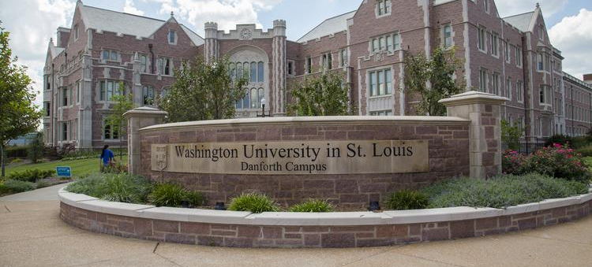
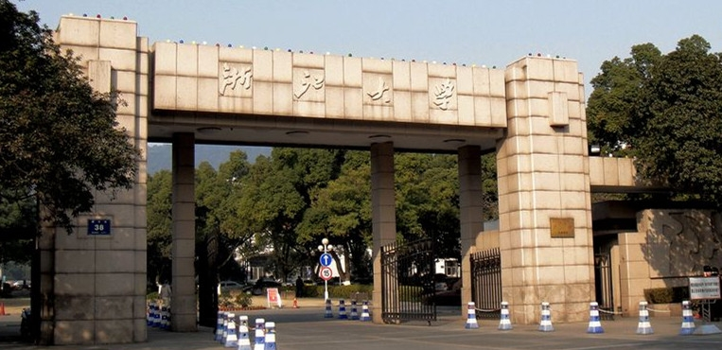
Education Backgrounds

Slide 4
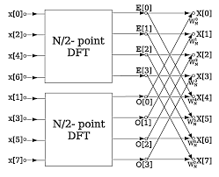
Work Experience
Data Science Engineer Intern in Xi’an Merit Data
Projects:
Analysis of sequential data for from Xi’an first aerospace institute
Intelligent noise recognition method of Haier air conditioner
Raised funds target customers prediction model for potential custom

Slide 5

Hobbies
Keep Thinking All The Time

Slide 6

Prospect
How I know Micron
Why I choose Micron
What I want to do in the future

Slide 7
Thanks

